Slide 1


Advanced Methods in Data Science - DTSC104
Milestone 2
SVM algorithms
Introduced by
Omnia Gad
Nardeen Shaheer
Nourhan Reda Abdelall

Slide 2
SVMs algorithms :
Support vector machines (SVMs) are a set of supervised learning methods used for:
➢classification
➢Regression
➢outliers detection
The advantages of support vector machines are:
Effective in high dimensional spaces.
Still effective in cases where number of dimensions is greater than the number of samples.
Uses a subset of training points in the decision function (called support vectors), so it is also memory efficient.
Versatile: different Kernel functions can be specified for the decision function. Common kernels are provided, but it is also possible to specify custom kernels.

Slide 3
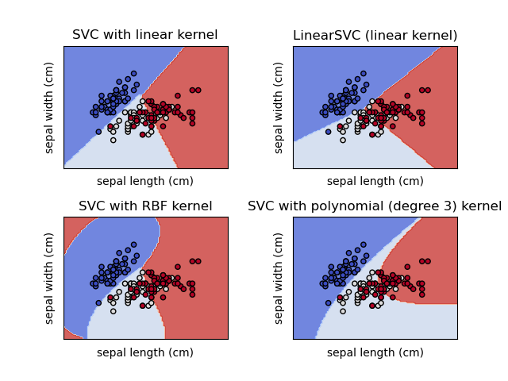
Classification of SVM:
SVC ,NuSVC ,linear SVC are classes
capable of performing binary and
multi-class classification on a dataset
How ever linearSVC are similar methods, but accept slightly different sets of parameters and have different
mathematical formulations , On the
other hand
linearSVC s another (faster) implementation of
Support Vector Classification for the case of a linear
kernel

Slide 4
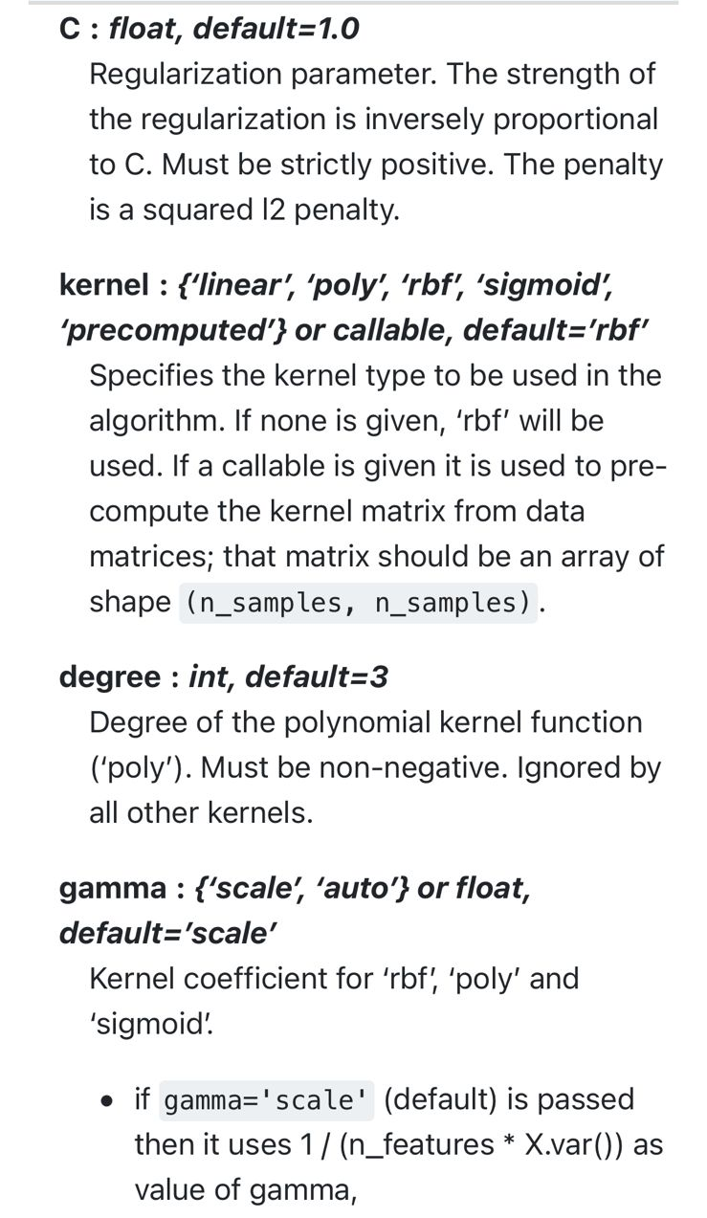
SVCs decision function depends on some subset
of the training data, called the support vectors
Some properties of these support vectors can be
found in attributes support_vectors_,
support_ and n_support
And according to the case of our data we use SVC
In our case we use different values for kernel parameters ;
Kernel=[‘linear’,’rbf’,’poly’,’sigmoid’]
And this is the concolusion:
The best of them is rbf according to
Accuracy and mse.
And according to the result we use rbf
with changing the value of Gamma

Slide 5
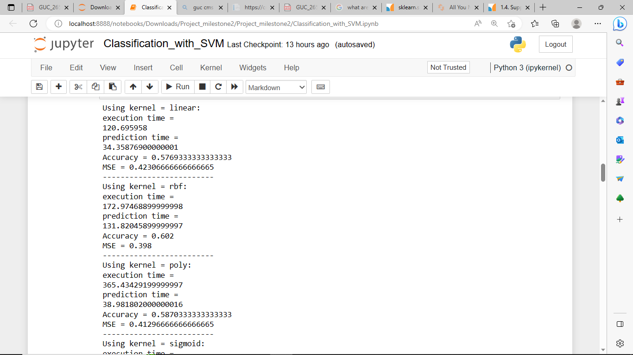
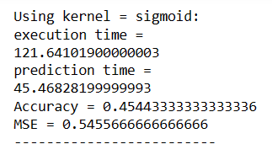
Gammas=[‘scale’,’auto’,’gamma=0.1,1,10,100]
also we change the parameters of cs
Cs=[0.1,1,10,100]
Last conculosion:
The best kernel is rbf according to accuracy and mse.
The best gamma with rbf is equal to 10
The best CS is 100 with rbf, C=100
We try to use poly kernel and change the degree
Degrees=[0,1,2,3,4,5]
And we noticed that as the degree value increase the better
Accuracy we have .

Slide 6
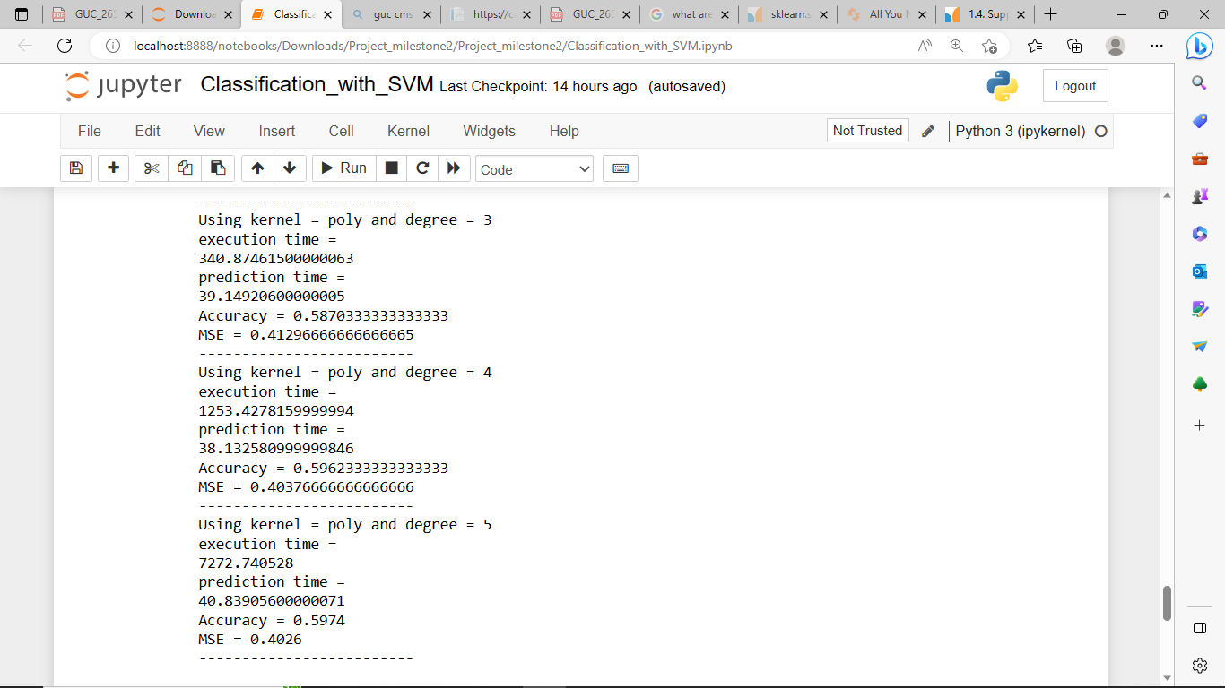
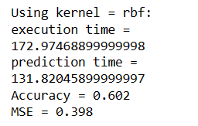
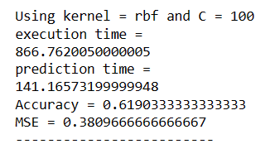
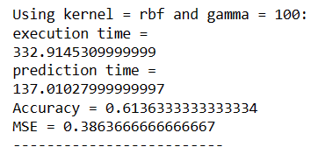
We noticed that poly kernel take more time in training and less time in predictions compared to other kernels .
We noticed that rbf takes the more time in prediction , and the time increase with the increase of C and gamma.

